Slide 1
TITLE OF PROJECT RICE GRADING
PROF: S.Raj kumar sir
TEAM-8
MEMBERS:
C.CHANDAN KUMAR(16MIS1044)
M.DHANUSH KUMAR(16MIS1046)
V.CHANDRA SHEKAR(16MIS1096)
G.PAVAN KUMAR(16MIS1097)

Slide 2
SOFTWARE REQURIMENTS :
Mat lab (VERSION9.3.0.713579-64 bit.)
OBJECTIVES:
Checking the quality and grading of the rice grains.
PLAT FORMS:
matlab 2017b trail version
WORK DONE IN PREVIOUS REVIEW:
Converting the image into negative and find the impurities in the rice using matlab.

Slide 3
COMMENTS RESOLVED:
IMAGE SEGMENTEATION is done
WORK DONE :
edge detection and image segmentation to find the impurities in the rice like insects.
WORK TO BE DONE IN NEXT REVIEW:
finding the chalkiness in the rice.

Slide 4
Image segmentation:
a = imread('rice4.png'); I=rgb2gray(a);
I2 = I - background; %subtract the background a1=I2
I3 = imadjust(I2); %to increase the contrast of processed image a2=I3
bw = imbinarize(I3); % create a binary version of processed image bw = bwareaopen(bw, 50); a3=bw

Slide 5
cc = bwconncomp(bw, 4) cc.NumObjects grain = false(size(bw)); grain(cc.PixelIdxList{6}) = true; % view the rice grain. a4=grain
subplot(2,3,1), imshow(a1) subplot(2,3,2), imshow(a2) subplot(2,3,3), imshow(a3) subplot(2,3,4), imshow(a4)

Slide 6
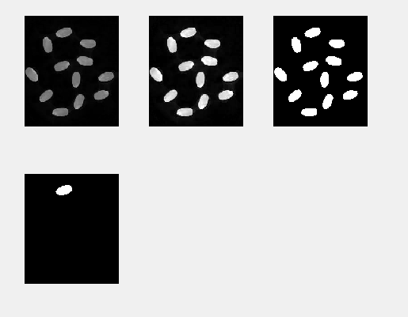
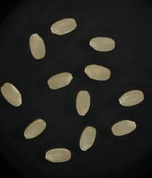
Input and output images:

Slide 7
Edge detection:
rgb = imread('rice10.jpg');
imshow(rgb)
I = rgb2gray(rgb);
imshow(I)
hy = fspecial('sobel'); % here we find the horizontal edges by a 3x3 matrix
% [ 1 2 1
% 0 0 0
% -1 -2 -1 ]

Slide 8
hx = hy'; % here we find the vertical edges by a 3x3 matrix
% [1 0 -1
% 2 0 -2
% 1 0 -1]
Iy = imfilter(double(I), hy );
Ix = imfilter(double(I), hx );
gradmag = sqrt(Ix.^2 + Iy.^2);
figure
imshow(gradmag,[])

Slide 9
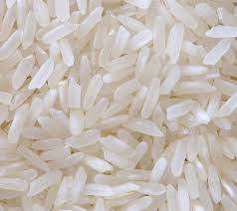
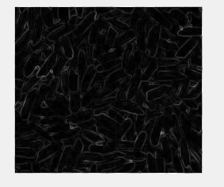
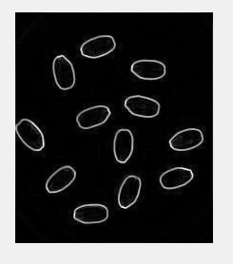
Input and output images:

Slide 10
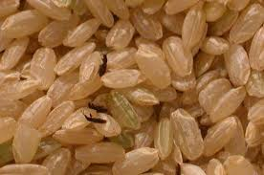
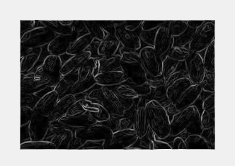
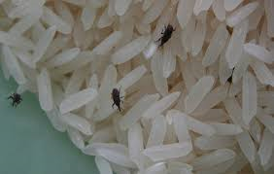
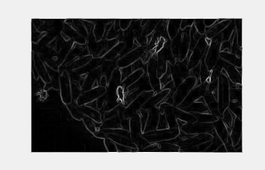
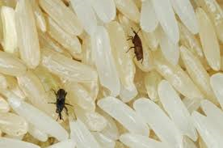
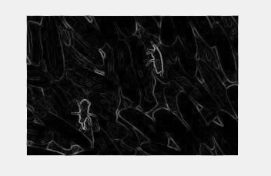

Slide 11
REFERENCES:
Paper by Wan Putri N. W. M. Tahir, Norhaida Hussin, Zaw Zaw Htike and Wai Yan Nyein Naing Department of Mechatronics Engineering, Faculty of Engineering, International Islamic University Malaysia, Malaysia
[1] D. M. Hobson, R. M. Carter, Y. Yan. 2007. “Characterisation and Identification of Rice Grains through Digital Image Analysis” University of Kent.
[2] Bin Lv, Bin Li, Sha Chen, Jian Chen, Bo Zhu. 2009. “Comparison of color techniques to measure the color of parboiled rice” Huazhong Agricultural University.
[3] Fumiaki Takeda, Hisaya Uchida, Take0 Tsuzuki, Hiroshi Kadota and Satoshi Shimanowhi. 2002. “A Proposal of Grading System for fallen rice using Neural Network”, Kochi University of Technology.

